Slide 1


The Classical Legacy

Slide 2
Aristotle and Plato
Aristotle’s encyclopedia of knowledge vs Plato’s dialogues.
For Aristotle, each field of inquiry has its own subject matter and methods. Aristotle’s work also shows a greater interest in empirical research and in devising methods appropriate to learning from experience.
For Plato, the emphasis is always the search for immutable (eternal) truths, as evinced in mathematical theorems and proof. Time is a moving image of eternity.

Slide 3

The Legacy of Aristotle and Plato
Platonism and Aristotelianism are grand philosophies that have exerted a profound influence on the development of the natural sciences in the west. However, with the recovery of Aristotle’s works in the 12th and 13th century, and the reconciliation of Aristotle’s philosophy with Christianity (1265-1274) by Thomas Aquinas (and others), Aristotle’s central philosophical teachings (esp. logic, physics, cosmology) dominated intellectual life in Europe through to the end of the 17th century.

Slide 4
Artifice and Nature
All things either have a nature or they do not. If they do not, they are artifacts. The difference is between things that are found in a pure state of nature and so are a union of form and matter, and those that are product of human contrivance. Artifacts do not have a form, which is to be found in their maker.
Having a nature is synonymous with having a principle of development. All natural things have such a principle.
Aristotle's distinction between nature and artifice is the insistence that reality consists in the purpose or telos determined by the union of form and matter. Artifacts of human production, however, fail to achieve this kind of unity, as evidenced by their having a number of uses or extrinsic ends. In systematized art, for example, the material itself is important only as a substrate to be manipulated by the artisan.

Slide 5
Mathematical vs Causal Explanations
The mathem­atical and empirical aspects of the world are really separate and distinct, and so scientific endeavors should be organized in a manner that reflects this ontological separation.
There is the celestial realm, which is immutable and eternal, like the theorems of mathematics. Plato argued that science was exclusively con­cerned with mathematics and, in particular, with the four branches of mathematics that he recognized — geometry, astronomy, music, and algebra.
Aristotle parted company with Plato on this score. He agreed that mathematics and empirical science needed to be firmly separated but reckoned that there could be a science proper to both. In particular, he argued that mathematics was properly restricted to formal unchanging things, whereas empirical science was restricted to changing things. Mathematics would look for regular, immutable relationships, whereas science would study the formal and efficient causes that bring about empirical change, but it would proceed in a wholly non-mathematical way.

Slide 6
Aristotle’s Two-Sphere Cosmology
The celestial realm: (the domain proper to mathem­atics), perfect, immutable, and timeless, consisting of clock-like, unchanging motions in uniform circular motion.
The terrestrial realm: (the domain proper to causal explanations), imperfect, mutable, consisting of up and down motion.
There was a science of the stars and planets that was mathematical and another science of earthly things that was causal.

Slide 7
Aristotle’s Ontology
Celestial things were unchanging, non-earthly things that displayed mathematical patterns. The stars and planets are not made of the same sort of stuff that made up the earth. They are made of a 5th element called quintessence or the aether.
Earthly things, in contrast, were constantly changing according to causal laws of a sort but there were no mathematical patterns proper to this development. Earthly things were compounds of four elements: earth, air, fire, and water. These elements in turn contained the four qualities of heat, cold, dryness, and humidity, combined in pairs. Each of these elements had a “nature” or a natural tendency: the tendency of the Earth and earthly things was to go down to the center of the cosmos, the tendency of water to sit on earth, the tendency of air to rise above water and the tendency of fire to rise above air.

Slide 8
Aristotle’s Elements
Why are earth, air, fire and water elements for Aristotle? Just why these things are elements for Aristotle is not entirely clear. If we look at the case of air, for example, it seems safe to say that Aristotle wasn’t thinking of mixed air; that is, he wasn’t thinking in terms of air being a mixture in the way that we now think of it. He would think of air as a pure element. When we think of something being a pure element, we ask ourselves whether it can be broken down. We know that water can be broken down, so it is not an element. In a similar vein, we know that carbon dioxide can be broken down, so it also is not an element.
Aristotle, however, is not thinking in these decidedly modern terms. He’s thinking that air is a whole thing that nevertheless does somehow mix with other elements to make up bodies of ordinary experience. For some of his predec­essors, air has a mythical and cosmological aspect because it was identified with respiration and life. But Aristotle concept­ualizes air in non-cosmological, non-technical terms. His claim is simply that there are elements, and he doesn’t sustain this claim with a theory of the elements. Why these things are elements for Aristotle we can’t say for certain.

Slide 9
Aristotle and Common-Sense
Aristotle aligned his science with common sense, which tells us that heavier things fall more quickly than lighter things. The rate at which an object falls is a function of the proportion of the 4 basic elements, which in fact differs for every object of experience. The consequence is that it is impossible to formulate a general principle of law governing falling bodies.
For Aristotle, an earthly body falls because it is seeking its natural place. The greater the proportion of earth in this object, the more readily it will realize its tendency to return to its natural place.

Slide 10

Geocentrism
For Aristotle, the earth sits motionless (geostatic) at the center of the cosmos. This position squares with common experience that seems to tell us that the earth does not move (we have no sensation of this at all).
Aristotle’s view is anthropocentric – a cosmology that is based on the our point of view and the authority given to common-sense experience and observation.

Slide 11
The Celestial Realm
The celestial realm, Aristotle maintained, is a giant shell that surrounds the world. The stars are attached to this sphere and turn as the shell itself is turned. The Earth is a second sphere that is located in the center of the outer shell on which the stars are attached.
In between the central sphere of the Earth and the other sphere of the fixed stars there were other spheres — one for the Moon, another for each of the known planets, Mercury, Venus, the Sun, Mars, Jupiter, and Saturn. Each of these spheres was nested inside the other with a planet attached to it. Motion was imparted by the first mover from the outside — as the outer sphere containing God moved, the sphere on which the stars were fixed moved, then the spheres on which the planets were attached. The entire structure was like a giant mechanism — a system of interconnected wheels.

Slide 12
The Motions of the Planets
The ancients knew that some points of light behaved in odd ways. On Aristotle’s view, all celestial objects were supposed to move in perfect circles — in other words, they should cover the same amount of space in the sky in the same time.
Most of the stars were “fixed” in comparison to one another. They moved around the Sun but always in the same relationship to one another. Other stars, however, exhibited very eccentric behavior. These eccentric stars wandered around a great deal. They seemed to approach and then recede from the Earth. Some stars exhibited this wandering behavior to a greater degree than others did and they would appear as very bright objects at some times of the year and quite dim at others.

Slide 13
Motion of the Planets (cont.)
Some of these wandering stars or planets never moved very far away from the Sun; these were called the inferior planets. Mercury always stays within 28° of the Sun’s disk. Venus stays within 45°. Both planets move in a very slow shuttle across the face of the Sun. When east of the Sun, they appear as evening stars; after moving westward across the Sun’s moving disk, they become morning stars. In between, they can’t be seen at all.
The other planets, known as the superior planets, differed from the inferior planets in their not being restricted to the same part of the sky as the Sun. Sometimes they are close or in conjunction; at other times, they are 180° across or in opposition

Slide 14
Motion of the Planets (cont.)
Another problem was that the planets all lie in a plane and never depart much from the ecliptic. The stars are distributed throughout the entire stellar vault. Further to this, as the planets make their way round the central Earth, they are seen to retrograde; that is to say, they seem to stop, move backward for a bit, and then move forward again. Mercury exhibits this phenomenon every 116 days, Venus every 584 days, and Mars every 780 days. The planets are supposed to move in perfect circles but they stop, turn around and then start forward again.

Slide 15
Saving the Phenomena
The question for a proponent of Aristotelian science is this: how are these eccentric phenomena to be reduced to an underlying order? One way out was to think of the Sun and the planets as the same kind of entities and as somehow different than the fixed stars. This way was not explored for some time because it entailed thinking of the planets in physical terms. Another way out was to see if Aristotle’s basic idea that the celestial realm is a realm of mathematical perfection could be salvaged by adding more mathematical complexities. This was the avenue that astronomer explored for the better part of two millennia. It was the repudiation of this project, in part, that gave rise to the scientific revolution that we now associate with the names of Copernicus, Galileo, and Newton.

Slide 16
Aristotle on Causation
4 causes, all must be present: material, efficient, formal, and final cause (telos, purpose).
Each of the elements has its natural place. Moved away from that natural place, a body will strive to return to it. Thus, to explain a motion one has to attribute a purpose or final cause to it; that is, the object is moving because it has a tendency to return towards its natural place.
The idea of a natural place also generated arguments against the possibility of a vacuum: places are tied to bodies. Bodies have natural places but a void, which is a place that has no bodies in it, must therefore be an absurdity.

Slide 17
Projectiles
Motion requires the constant attention of a mover — an efficient cause of some kind. In a void, there was only a moved object and no mover. Aristotle, instead, explained projectile motion by the air rushing behind a spear and pushing it forward; a missile remained in motion not because of the missile or the mover but because of the medium. Its speed was directly proportional to the force applied and indirectly proportional to the resistance of the medium.
During the Medieval period, this doctrine came to be known as antiperistasis — the air, pushed forward by the object, changes direction, moves around the rear of the object, changes its direction once more, and then gives the projectile a forward push once again.

Slide 18
The Exact Sciences in Antiquity

Slide 19
Science and Democratic government
We tend to assume that science and democracy are natural allies – that science encourages and supports democratic values and institutions and, in turn, democratic values (esp. respect for autonomy), if not a necessity, encourages the flourishing of scientific values and institutions.
The Greek city states were democratic in some sense of what we now mean by the term democratic. All citizens were encouraged to participate fully in intellectual life and the writings of the Greek authors tends to run across a number of subject, all at the same time.
Under the dictatorship of Alexander, which created a firm separation between political and ethical questions, on one hand, and questions about the world around us (nature), a different sort of science emerged, something we now call an exact science. An exact science is a science that is geared toward measurements carried it with instruments (hence = exact). Alexandrian science was geared towards quantitative analysis.

Slide 20
Theory vs quantitative analysis
When we think about science, we tend to think in terms of grand theories – Newton, Lavoisier, Maxwell, Darwin, Einstein.
One reason for this is a view about the aim of science, viz. science aims to give us true representations (theories) of the world around us. Our histories tend to highlight the emergence of these great theories, and by and large are insensitive to the importance of quantitative analysis (measurement) and the role that technology has played in the growth of scientific knowledge.
This view about the aim of science influences and shapes our beliefs and the comparative importance we place on the development of instrumentation, devices, equipment, experimentation, on one hand, and on the production of theory, on the other.
We tend to assume that theories always appear first in the order of things, and then scientists consult nature in the form of observation and experiment to asses whether these theories are well-founded. On this view, science is the product of homo sapien (thinking) and not homo faber (making).

Slide 21
The Character of Alexandrian Science
Euclid. The Elements. Systematic presentation of geometrical knowledge based on the method of postulation. Start with axioms (statements that are self-evidently true, such as “a line if the shortest distance between two points”), then move onto postulate (statements that are accepted without proof. Euclid accepts the following as postulates:
All right angles are equal to one another.
only one line can be drawn through a given point so that the line is parallel to a given line that does not contain the point.
Finally, deduce a series of theorems.

Slide 22
Euclid’s influence
The method of postulation has exerted an enormous influence on a number of fields but especially theoretical physics. Isaac Newton’s monumental Mathematical Principles of Natural Philosophy (16787) is written in the style of Euclid.
Postulation is ONE of the forms of styles of reasoning that are characteristic of the natural sciences: postulation, analogy (analogous models), statistical inferences, evolutionary histories, experimentation. Theories tend to have a shelf life, but the styles of reasoning have an enduring character.
These styles allow scientists to ask specific kinds of questions that they could not ask otherwise. They do not determine whether these questions are true or not.

Slide 23
Archimedes, Apollonius, Aristarchus
All made important contributions, especially to the science of mechanics (the pulley, gear, etc.).
Aristarchus, in particular, is remembered for his suggestion that the Sun is situated at the center of the planetary system and that the Earth rotates on an axis. We know nothing about the thinking that informed this conjecture, only that it was rejected out of hand by his successors in Alexandria.
When Copernicus was a young man (27), he travelled to Italy and spent 3 years in Bologna, mostly studying works in the humanities by Greek (and Alexandrian authors). He was well-acquainted with Aristarchus’ work. When he left Italy in 1501, he had the idea for his new astronomy.

Slide 24
The Ptolemaic System
Ptolemy’s great work, The Almagest, was completed in ca. 150 AD, translated into Arabic in 950 AD and then into Latin ca. 1460 AD.
It was the most influential astronomical theory in the West until the mid-1600’s when it was gradually supplanted, first, by the Copernican system and, second, by the Copernican system as modified by Newton.

Slide 25
Saving the Appearances
Ptolemy takes the task of astronomy to be that of explaining the apparently irregular movements of the heavenly bodies in terms of combinations of uniform circular motions.
The Ptolemaic system is more a mathematical device for computing the motions of planets than any cosmological device for the explanation of the universe. Furthermore, the mathem­atical arrangement is designed to bring order into the movements of the stars and planets as seen from the earth. This, a geocentric scheme, seemed the most logical.
his system must be understood as referring only to the angles at which planets are observed; that is to say, to their angular motion as seen projected against the background of the fixed stars. Hence, the theory ‘saves the appearance’ rather than attempts to give a picture of the orbit in space of any one planet. The path of the planet was a purely geometrical device to express the mathematical analysis, since algebraic methods were still far too crude for the purposes.

Slide 26
Geometrical Devices
Eccentric. The planets seem to approach and then recede from the Earth. Postulate that the Earth is not at the center of the cosmos but slightly off center. This point, or the eccentric, is the center of motion, and not the Earth. This strategy enabled Ptolemy to hold that the planets do not move uniformly with respect to the fixed stars as seen from the Earth, even though its motion in a circle is in fact uniform. If the planetary system is an eccentric system, rather than a homocentric system, there will be times when the Sun or planet will be very near the Earth (perigee) and times when it is very far from the Earth (apogee). Thus, we should expect a variation in the brightness of the planets.

Slide 27
Epicycle on Deferent Construction
The mathematical mechanism for the planets consists of a small circle, the epicycle, which rotates uniformly about a point on the circumference of a second rotating circle, the deferent. The planet, P, is located on an epicycle and the center of the deferent coincides with the center of the Earth. The curve resulting from the combination of epicycle and deferent is consistent with retrogradation.
We can add as many epicycles as are needed to get the planet at the right place at the right time.
With this device, we can generate almost any orbital shape.

Slide 28
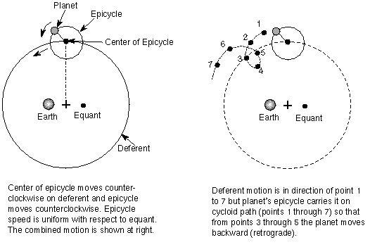
Ptolemy’s Epicycle on Deferent Construction

Slide 29
The Equant
In order to bring his planetary models in line with observations of the positions of the planets, Ptolemy has the planets speeding up and slowing down as they move along the epicycle.
We may be uncomfortable with the suggestion, defenders of Ptolemy would argue, that the planets can actually speed up and slow down in their orbits. Imagine, though, that you are an angel. As an angel, you would be able find a place where you could enjoy the planet moving uniformly around you. That place is the equant. In effect, what this argument is asserting is that there is a place in our mind where a planet can be seen not to be violating Aristotle’s teachings.

Slide 30
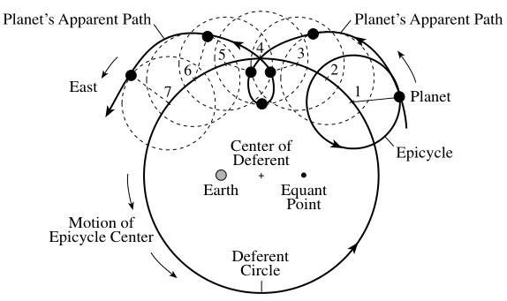
Retrograde Motion

Slide 31
Issues for the Ptolemaic Planetary Theory
Abandons egocentricity, but holds onto geostaticity. A point in empty space (i.e., a mathematical point is the reference for planetary motion). The Earth is no longer at the center, which clashes with Aristotle’s physics.
Gives up uniform (perfect motion). The target of Copernicus’ rejection of the Ptolemaic system is the equant, which , in hindsight seems like a very conservative reaction, not the revolutionary one we would expect.

Slide 32

The Copernican Revolution

Slide 33
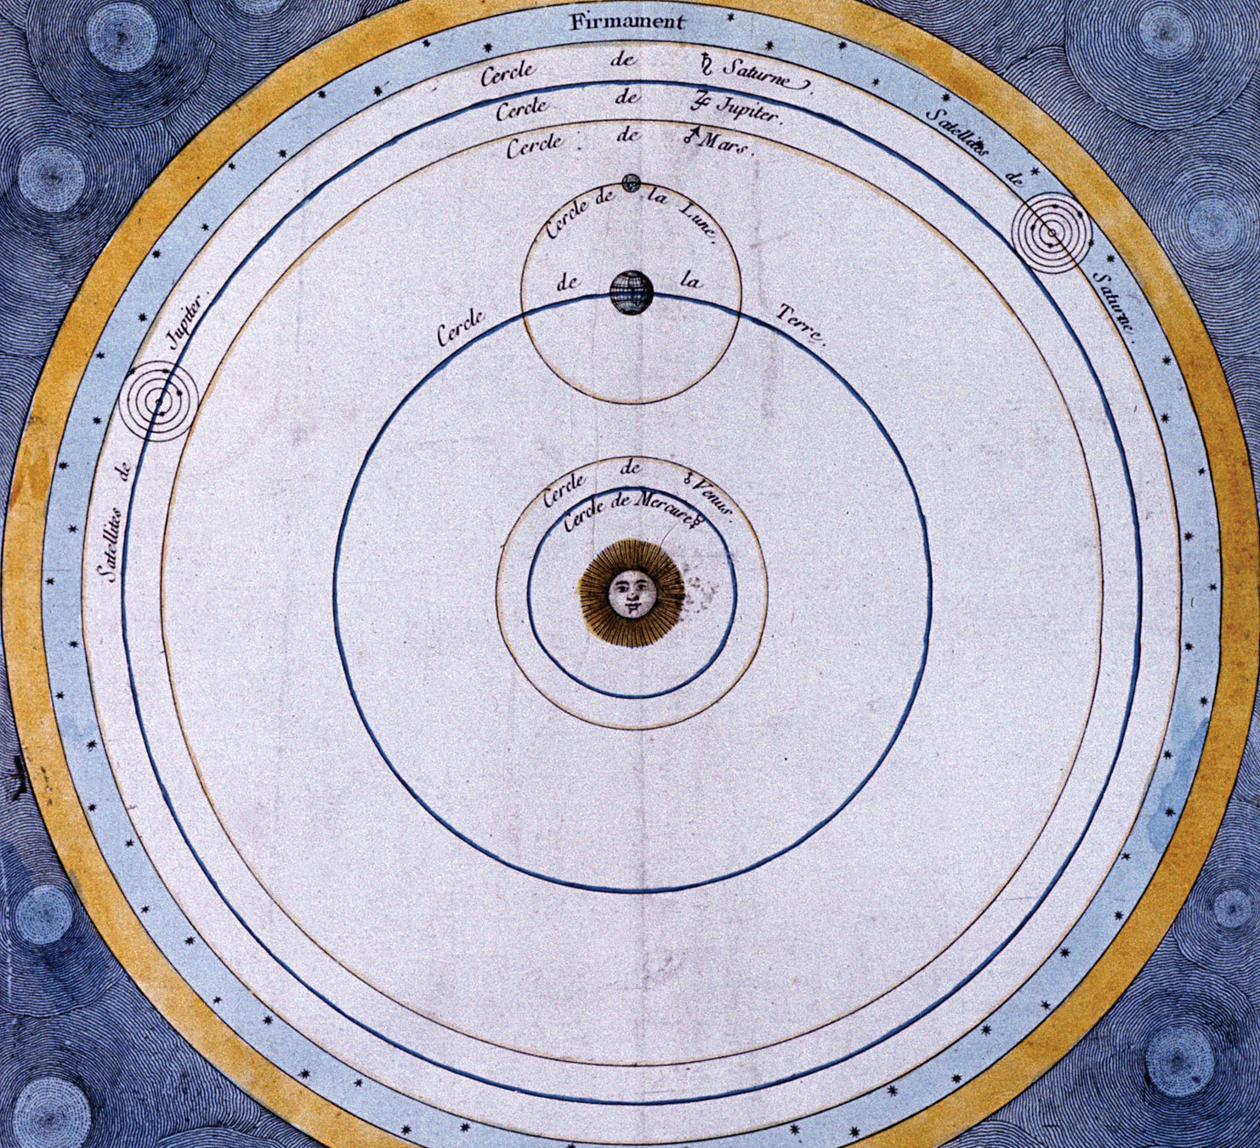
The Copernican System

Slide 34
Commentariolus (161)
7 central theses:
No one center of all the celestial spheres. The Earth is the center of the lunar orbit; the Sun is the center of the planetary orbits.
The Earth is the center of gravity but not of the world. Obvious issue with physics.
The planetary spheres revolve around the Sun at the center. Here he advances a clearly heliocentric model, but later will move the Sun ouf of the center and replace it with a heliostatic model. Most importantly, here he treats the Earth as just another planet, exploding the received distinction between a star and a planet.

Slide 35
Commentariolus (con’t)
The distance of the Earth from the Sun is INCOMMENSURABLE with the dimensions of the firmament. By attributing the Sun’s motion to the Earth, Copernicus is under no constraint to hold that the cosmos is small. Just how big is he cosmos? Well, it can’t be infinite but it can be as big as it needs to be.
Stellar parallax. Lack of this was used by Copernicus as evidence for a large cosmos. It was used by his opponents to suggest that the Earth can’t be in motion at all.
Think about the Earth’s motion is an immense universe. It is not really going anywhere; it is hardly moving at all. An angel on the edge of the cosmos would see the Earth as a blemish on the surface of the Sun.

Slide 36
Commentariolus (con’t)
The Earth performs more than one motion – annual revolution around the Sun; rotation of its axis’ wobble of its axis to account for the precession of the equinoxes.
The motion of the Earth explains the apparent motion of the heavenly bodies. Gives a clear and natural explanation of retrograde motion.

Slide 37

On the Revolutions of the Heavenly Spheres (1543)
Busied himself collecting data on stellar positions and finished his great work in 1543.
Georg Rheticus visited him and published an account of the Copernican system in 1540 (First Narration). He then convinced Copernicus to publish his great work, which Copernicus was given on his death bed.
Book I presents the propositions of the “Commentariolus” together with the reasons, astro­nomical and geometrical, for accepting them. Book II is devoted to spherical astronomy; Book III, to the length of the year and the orbit of the Earth; Book IV, to the Moon and its eclipses; Books V and VI, to the planetary motions.
The work did not immediately win readers. Twenty years passed before a second printing appeared (Basel, 1566), and another fifty before there was a third (1617). Even today, the complete work is not available in English. Yet in this long-neglected book Copernicus, almost single-handed, overthrew the old geocentric theory and established a heliocentric astronomy in its place. Some of his “proofs” are now outmoded, chiefly because Copernicus had to rely upon observations and measurements made with the crudest of instruments. Some of his hypotheses later generations of astro­nomers have refused, notably the one concerning that motion of the Earth which, according to him, explains the precession of the equinoxes which was first detected by

Slide 38
The essential elements that came to be identified with the Copernican system — the abolition of epicycles and deferents, the dissolution of the spheres, the Sun a star, the infinite expansion of the cosmos, easy and accurate computations of planetary position — are not to be found in it. In every respect except the Earth’s motion, the work is closer to ancient texts, especially to Ptolemy’s Almagest. It is at once ancient and modern. It is conservative and radical. In retrospect, we can state that the significance of De Revolutionibus consists in what it inspired others to say-- it was a revolution making rather than a revolutionary text. It shifted the direction in which scientific thought developed.
Though it is modeled on Ptolemy’s Almagest, De Revolutionibus takes the bold step of rejecting the Ptolemaic system because, as Copernicus says in the Preface of his great work, it leads to great inaccuracies in prediction. It was the concerted way that Copernicus investigated the mathematical consequences of the Earth’s motion and worked to reconcile these with extant astronomical knowledge that was the heart of his revolutionary work (Kuhn 1957: 184). The Copernican revolution was not a revolution in the techniques to compute planetary position but it began as one.

Slide 39
Copernicus as a revolutionary?
In technical respects, Copernicus was traditional. He argued, for example, that only a uniform circular motion or a combination of such motions could account for the celestial phenomena. He was even more Aristotelian than others in his rejection of the equant — Copernicus would not consent to the violation of uniform and systematic motion of a sphere that is implicit in the use of an equant. However, his central argument for a moving Earth was based on his roots in tradition; i.e., because the Earth is a sphere, it too must participate in the compounded circular motions that, he contended, are natural to a sphere.
The message here is that we can have an Aristotelian universe and transpose the motions of the Sun and the Earth. According to Copernicus, all matter, celestial and terrestrial, aggregates naturally into spheres. The spheres then rotate of their own nature. A bit of matter separated from its natural position will continue to rotate with its sphere.

Slide 40
Difficulties for Copernicus’ Theory
It was inconsistent with the dominant physics of the day — it presumed, for example, that there were two different centers of rotation. To complicate matters, Copernicus had no physics of a moving Earth. He did not conceive the Earth’s motion for physical reasons. (Kepler, Galileo, Descartes, and Newton worked hard to erase this inconsistency. We will examine their views in the coming chapters.)
Copernicus contended that it was somehow more natural to have the Sun, which he thought of as a unique celestial body at the centre of things, and the Earth as a planet. In terms of our present view, this arrangement makes a great deal of sense — we know that the Sun, which is a source of heat and light for the entire planetary system, is a different kind of body than the Earth or any of the other planets. The Copernican system afforded a different kind of anatomy of celestial bodies, one that made a clear distinction planets and fixed stars with the Sun as one of the fixed stars. The obvious objection, however, was that if the Earth is a planet, like the other planets wandering through space, it seems clear that we should have a physics for a moving Earth. And there was no physics; i.e., there was no explanation as to how it is that the Earth, a massive body, can be set in motion throughout space.

Slide 41
The Copernican System as a Physical System
Copernicus maintained that the motion of the Earth is real; that is, the Earth is a physical body that moves through real physical space. It was very difficult to reconcile this suggestion with the many epicycles and deferents that appear in Copernicus’ planetary constructions. Although Copernicus meant to describe and give a physical account of the planetary system with the Earth as a body moving through space, he was compelled to use purely geometrical constructions to account for astronomical phenomena. These two things did not fit well together.

Slide 42
Copernicus and the Church
For a nearly a half century, the religious implications of the Copernican system were overlooked and, in retrospect, there is a very obvious reason why. Few people read Copernicus’s great work and the majority of those who studied it carefully were astronomers working in the service of the Church. These astronomers persisted, with Osiander, in regarding the Copernican system as just a mathematical construction that makes no connection with reality. It is only when these physical questions are taken seriously that unwelcome religious implications for orthodox views are raised.

Slide 43
Copernicus and Common Sense
It’s evident to anyone that the Earth is not in motion; indeed, that it can’t possibly be in motion. We feel a horse in motion, and the faster we move, the more we feel the force of resistance against our skin. We certainly don’t feel the Earth moving, and most assuredly not at the tremendous speed called for by Copernicus’ claim that it revolves around the Sun every year. Though the Earth is supposed to move thousands and thousands of miles each second, we feel nothing. The clouds apparently feel nothing either. They just keep going around the Earth; they are not swept away. And the atmosphere, which is so incredibly light and airy that we can put our hand through it, is not swept away by the violent motion. So, which side do we take here? Common sense says the Earth is not in motion. Copernicus says that it is in motion. If we side with Copernicus, we run up against common sense.

Slide 44
The Relativity of Motion
It was Galileo who first attempted to defend Copernicus against this argument by advancing a principle of the relativity of motion, which was first described in his Dialogue Concerning the Two Chief World Systems (1632). Using the example of ship travelling Galileo reasoned that at constant velocity, without rocking, on a smooth sea, any observer carrying out experiments below the deck would not be able to tell whether the ship was moving or stationary. The fact that the Earth orbits around the sun at approximately 30 km/s offers a somewhat more dramatic example: it is technically an inertial frame, and according to Galileo’s principle, the laws of motion are the same in all inertial frames.

Slide 45
The New Astronomy and Common Sense
Is science really an intellec­tual representation of the truths that are manifest to us in ordinary experience. Copernicus’ view seemed to suggest the opposite, namely, that science is opposed to common sense. Common sense deceives us. Ordinary sensation misleads us. We need to investigate experience more carefully — perhaps even conduct some experiments — because our folk wisdom cannot be trusted. This is the first scientific theory that aligned itself against common sense and thereby at one and the same time against the wisdom of the ancients and the common sense of the ordinary person. And by standing against the ordinary person, Copernicus seemed to be saying science demands a specialized kind of knowledge.

Slide 46
Stellar Parallax (again)
Stellar parallax is the apparent displacement of an observed object due to a change in the position of the observer. If there stars are situated at enormous distances, as called for by Copernicus. This angle should be measurable, in principle, which would constitute direct empirical evidence produced by measurement of the movement of the Earth through space, as stipulated by the Copernican system.
Stellar parallax was not measurable in the early modern period and would not be measured until 1838 by Bessel, using an improved heliometer (telescope with a split objective lens).

Slide 47
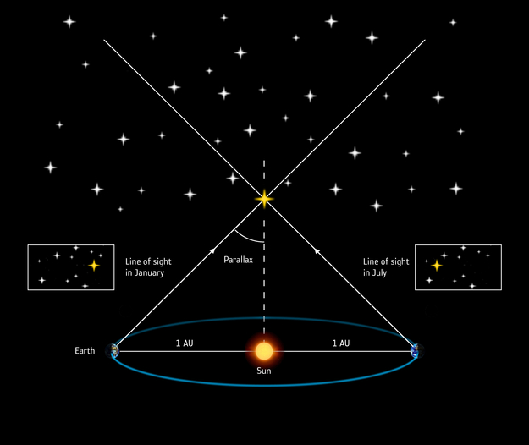
Measuring stellar parallax

Slide 48
The Status of the Sun
In the Copernican system, the Sun has no status at all — it is not a planet but motionless. It is not a center of planetary motions. At least in the Ptolemaic scheme, the Earth played a vital role as the hub about which the entire mechanism of the heavens turned. Copernicus retained the central role for the Earth, since even the planes of the planetary orbits oscillate in space according to the position of the Earth. The year, that is, the duration of the Earth’s complete revolution around the Sun, has a decisive influence on the motions of the other planets. In short, the Earth appears equal in importance in governing the solar system and the Sun itself, and in fact is nearly as important as in the Ptolemaic system.

Slide 49
Parsimony
The Copernican system gives a simpler picture of such phenomena as retrogradation, but it is not as simple with respect to its geometrical structure. Copernicus had to reintroduce circles to compensate for the abolition of Ptolemy’s equant and for the supposed fluctuation in the rate of the precession of the equinoxes. One commentator counts 48 Copernican circles, whereas the Ptolemaic system required 40 circles. Copernicus did not reduce the number of circles but actually increased them.

Slide 50
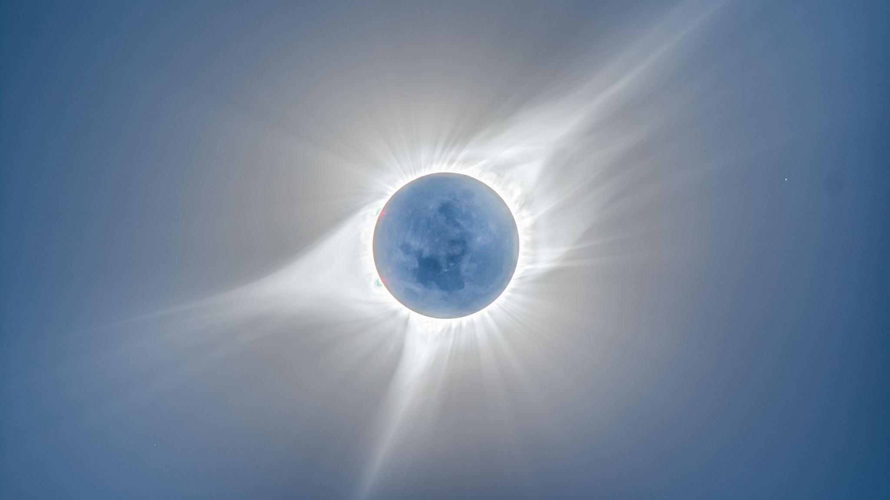
The Birth of Observational Astronomy

Slide 51
Tycho Brahe’s Observatory
Uranibourg., built (ca. 1576) on the island of Hven. The first observatory in the modern sense as an artificial environment to measure phenomena that occur in a pure state of nature. Established new standards of precision in measurement.
Observed a new star that appeared in 1574 and disappeared 18 months later (Tycho’s Star). Brahe believed that this was a new star (hence, supernova), but it was an exploding star. Prevailing opinion regarded this as a local meteorological phenomenon in the atmosphere. Brahe showed that the supernova did not change positions with respect to the other stars. He concluded, on this basis, that it was a real star, not a local phenomenon. This was the first evidence of the mutability of the heavens.
Brahe found that he was unable to measure stellar parallax for this new star or for any of the stars and so rejected Copernicus’ planetary system.

Slide 52
Stellar Parallax
Brahe found that he was unable to measure stellar parallax for this new star or for any of the stars and so rejected Copernicus’ planetary system.
On this basis, he concluded that the Earth is motionless at the center of the Universe OR the stars are so far away that their parallax is too small to measure.
Brahe’s question was insightful, but be refused to believe that the stars could so far away, so he concluded that the Earth was the center of the planetary system and that Copernicus was mistaken.
Brahe proposed a model of the solar system that was intermediate between the Ptolemaic and Copernican models (it had the Earth at the center). It proved to be incorrect, but was the most widely accepted model of the Solar System for a time.

Slide 53
Observation of the Comet of 1577
Brahe made precise observations of a comet in 1577. By measuring the parallax for the comet, he was able to show that the comet was further away than the Moon. This contradicted the teachings of Aristotle, who had held that comets were atmospheric phenomena ("gases burning in the atmosphere" was a common explanation among Aristotelians).
As for the case of the supernova, comets represented an obvious change in a celestial sphere that was supposed to be unchanging; furthermore, it was very difficult to ascribe uniform circular motion to a comet.

Slide 54
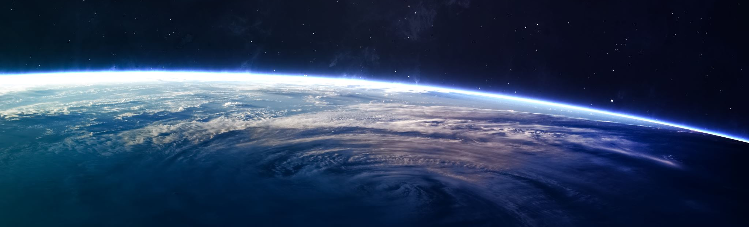
The Tychonic System
The Earth is at the center (or eccentric to the center) . The Sum moves around the Earth and the planets move around the Sun.
Observationally identical to the Copernican system (Sun and Earth are turned 180 degrees).
More than one center of motion.
Exercise in saving the appearances.

Slide 55
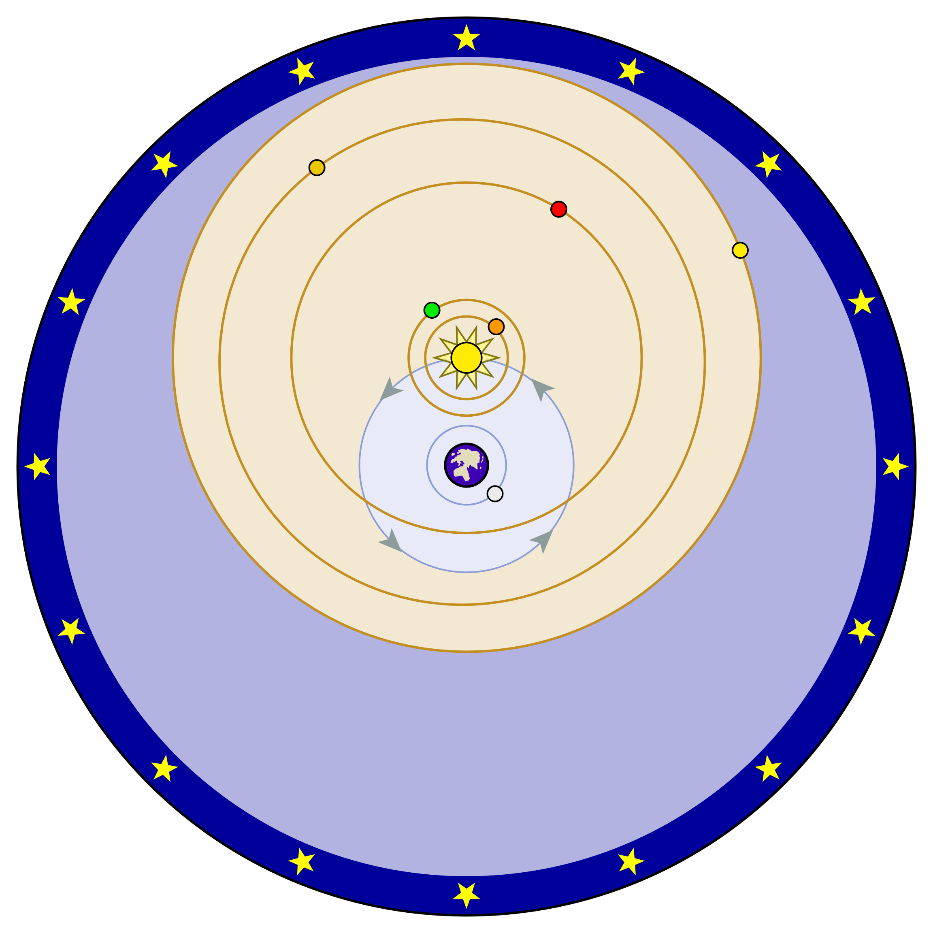
The Tychonic System

Slide 56
Phases of Venus
Galileo first observed phases of Venus in 1610 (but did not publish his observations until 1613). Galileo was able to observe Venus going through a full set of phases, a phenomenon that was impossible on the Ptolemaic system. (In order for Venus to be fully illuminated from the Earth, it would need to be on the far side of the Sun, which is impossible if Venus’ orbit is between the Earth and the Sun.

Slide 57
Brahe’s Greatest Discovery
As important as Brahe was to Renaissance astronomy, perhaps his most important discovery was Johannes Kepler, who accepted an invitation to work with Brahe in 1596.
Brahe had carried our discrete measurements of stellar bodies for more than 30 years, notably, Mars. Brahe died in 1601 and his collection of observations fell in Kepler’s hands.
While he was working with Brahe, Kepler was given two tasks: (1) find a way to reconcile the observations of Mars with Brahe’s model of the planetary system; (2) unpack a riddle concerning the camera obscura (which astronomers employed in their observations of the Sun. We will focus for the rest of the lecture on Kepler’s contributions to planetary astronomy and turn to issues concerning the camera obscura in a later lecture.

Slide 58
Kepler’s physical theory
“Astronomical problems are best resolved in terms of a mathem­atical analysis of their underlying physical causes.”
Kepler's brilliance is reflected in the way that he was able to extract a geometrically precise statement of the motions of the planets from the conceptual resources at his disposal (bits and pieces of Aristotelian physics, Copernicus' astronomical theory, and Gilbert's study of the magnet, etc.) that were not tailored for the purposes of physical astronomy.

Slide 59
Kepler’s Rules of Planetary Motion
It became apparent to Kepler in 1608-9 that the planetary orbits were not circles, and that no number of epicycles could account for the irregularities of their paths. Although at first unable to characterize these paths accurately, Kepler recognized that the planets accelerate as they approach the Sun, and slow down as they move away from it. In order to calculate the position of a planet at any time, he formulated two different laws.
The first states that the velocity of a planet varies with its distance from the Sun in such a way that a line joining the planet with the Sun sweeps out equal areas in equal times; and the second says that the velocity of a planet varies inversely as the distance from the Sun. The first is the form commonly known as Kepler’s second law of planetary motion, while the second is known as the inverse-distance law. Although Kepler initially regarded these laws as equivalent, by the end of the Astronomia nova he had corrected the distance law and recognized its incompatibility with the area law.

Slide 60
Kepler’s law of elliptical orbits
Kepler found that the only orbital shape that made sense of Brahe’s dats was the ellipse, and he conjectured that Mars (and the planets) move on ellipses around the Sun. An ellipse is kind of a stretched out circle. A real circle has the same width, or diameter, whether you measure it across or up and down. But an ellipse has diameters of different lengths. How long the longest diameter is compared to the shortest one determines the eccentricity (e) of the ellipse; it's a measure of how stretched out the ellipse is.
Circles have e=0 because their diameters are all the same. If an ellipse has one very short diameter, and one very long one, then it is a very stretched-out ellipse, and has an eccentricity nearly equal to 1.
Planets do move on ellipses, but they are nearly circular (e very close to 0). Comets are a good example of objects in our solar system that may have very elliptical orbits.

Slide 61
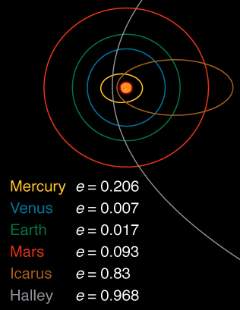
Eccentricities of orbits of the planets

Slide 62
Kepler realized that the line connecting the planet and the Sun sweeps out equal area in equal time. Look at the diagram to the left. What Kepler found is that it takes the same amount of time for the blue planet to go from A to B as it does to go from C to D. But the distance from C to D is much larger than that from A to B. It has to be so that the green regions have the same area. So the planet must be moving faster between C and D than it is between A and B. This means that when planets are near the Sun in their orbit, they move faster than when they are further away.

Slide 63
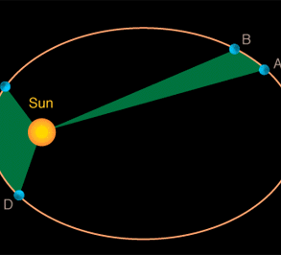
Kepler’s Second Law of Planetary Motion

Slide 64
Kepler and the Enchantment with Circular Motion
The ellipse law by itself has no observational consequences. Even if we have two orbital positions for a planet separated by a given time, we cannot calculate the area swept out in the same time. To do this, we would need the mathematical machinery of elliptical integrals, but this was not an option until 1750 or so.
Kepler attempted to use his elliptical law to calculate planetary positions along an ellipse in his Rudolphine Tables (1627), but his calculations were too difficult. Instead, he used the empty focus of the ellipse to make these calculations because the empty focus provided a uniform center of rotation.

Slide 65
Kepler and Newton
This solution gained a fair amount of currency in the seventeenth century, but it had no basis in physical theory. Moreover, these techniques signified a return to the deeply embedded ideal of uniform rotation, and certainly not the brave new astronomy proclaimed by Kepler's Astronomia nova. Even if one embraced Kepler's ellipse hypothesis as a likely candidate for the orbital shape, in the absence of the theoretical and mathematical tools that would put the area rule on the scientific map, the end result would be an astronomy that departed only negligibly from the astronomy of Ptolemy and Copernicus.
These considerations help to explain why the area rule is absent in the scientific liter­ature prior to Newton. Furthermore, since the area rule and the ellipse are tied together in Kepler's physical theory, there was no pressing reason for the astronomical community to treat Kepler's ellipse as more than a mere computational device.

Slide 66
Kepler’s Third Law of Planetary Motion
Kepler's 3rd Law: P² = a³
Kepler's 3rd law is a mathematical formula. It means that if you know how long it takes a planet to go around the Sun (P), then you can determine that planet's distance from the Sun (a).
This formula also tells us that planets far away from the Sun take longer to go around the Sun than those that are close to the Sun.

Slide 67
The Elements of Kepler’s Physical Theory
The Sun rotates on its own axis, carrying an image (species immateriata) of its body through the entire extent of the universe.
This image was held by Kepler to have the power to overcome the resistance of the planet to motion (the planet’s inertia) and carry it in its grasp.
As justification for this solar force, Kepler drew on William Gilbert's De Magnete (On the Magnet, 1600). Just as the Earth has the capacity to direct a magnetic needle north and south, Kepler held that the Sun (which is a spherical body as well) directs the motion of the planet.
A new style of reasoning: analogy.
For Kepler, the solar virtue is not a magnetic force as such. There is no true coition or coming together of the Sun and the planet in the manner specified by Gilbert for two magnetic bodies and the Sun is held, rather, to move the planet by the motion of its filaments. Kepler therefore conceived the solar virtue as a quasi-magnetic action that causes the planet to orbit the Sun.

Slide 68
Kepler and the Concept of Inertia
This suggestion implies that the planets have the same period of revolution, conforming to the Sun's rotation on its axis. In order to reconcile the different periods of the planets with his magnetic theory, Kepler submitted that the planets are inclined, because of matter, to remain in their place.
The introduction of the concept of inertia proved to be a remarkable event in the history of science, but Kepler conceived a body’s inertia as a resistance to motion and not, in the manner that we now associate with Galileo, as a state of rest or motion. Inertia, for Kepler, occasions a resistance to motion on the part of the planets. A planet's velocity, conse­quently, is determined by the strength of the solar force acting on the planet, relative to this resistance. More massive planets, Kepler contended, move more slowly on account of their greater inertia or resistance to motion.

Slide 69
Kepler and Circularity
The explanation for Kepler's conflation of magnetic attraction with gravitational attraction is complex but at least two points are pertinent.
The first was the enchantment with circularity, which was his birthright as a Renaissance astronomer.
The second was his goal of providing a physical basis for the Copernican theory. It appeared as though Gilbert's magnetic theory could be made to serve both ends, and Kepler clearly was less than rigorous in assessing its suitability for his new astronomy. The consequence of Kepler's enthusiasm for Gilbert's work is that the per­fect­ly simple planetary path projected by the Copernican system emerges, in his planetary theory, as an idealized model of planetary motion under the sole influence of the circum­solar force.

Slide 70
Galileo and the Scientific Revolution

Slide 71
The discrete optical sciences
Camera obscura, telescope, microscope
The technology (convex lenses, concave lenses, parchment, etc.) was available in antiquity.

Slide 72
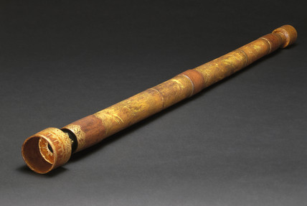
Replica of Galileo’s refracting telescope.

Slide 73
Three Sets of Observations
Galilean telescope: combination of convex and concave lenses. The refracting telescope magnifies only 21 times, but it only gives a very restricted field of view. As a result Galileo was only able to view about a third of the Moon through his telescopes. His engravings, therefore, are composites and not produced as a result of a single viewing.
Three sets of observations:
1. The spottiness of the Moon, which had been interpreted in a number of ways. Galileo observed the changing patterns of light and darkness over a number of evenings. The best explanation was that these changing patterns were shadows projected by features on the surface of the Moon; i.e., Galileo calculated that the surface features projecting these shadows were at least 4 times higher than the mountains of the Earth. Note: Mount Hadley is about the same height as Everest.

Slide 74
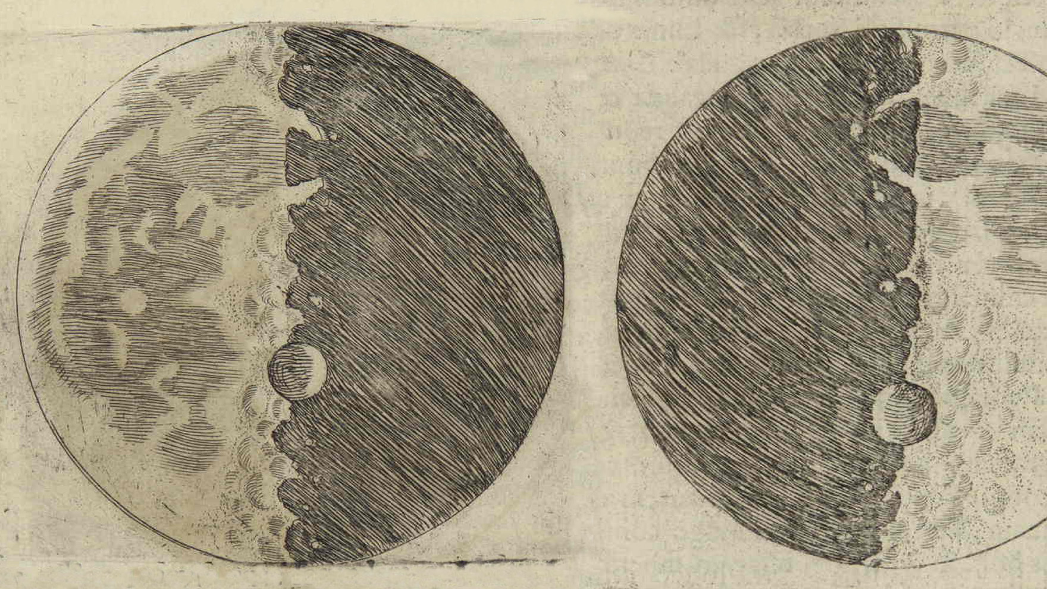
Galileo’s lunar landscapes

Slide 75
1. The Spottiness of the Moon
The spottiness of the Moon, which had been interpreted in a number of ways. Galileo observed the changing patterns of light and darkness over a number of evenings. He argued that the best explanation was that these changing patterns were shadows projected by features on the surface of the Moon; i.e., Galileo calculated that the surface features projecting these shadows were at least 4 times higher than the mountains of the Earth. Note: Mount Hadley is about the same height as Everest.
Galileo’s argument is an inference to the best explanation – namely, if it is true that the Moon is earthlike (i.e., it has valleys, mountains, etc., this will explain the changing patterns of light and darkness.

Slide 76
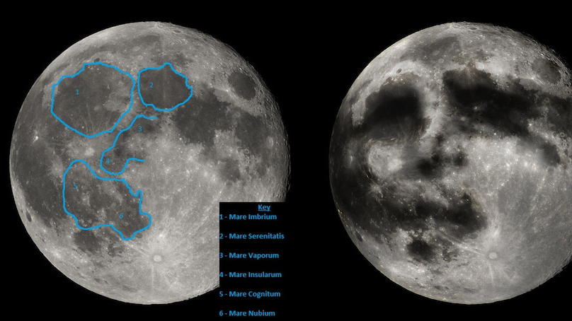
Man in the Moon

Slide 77
2. Milky Way
With Galileo’s telescope, the stars appeared brighter, but they were not enlarged and, if anything, appeared even smaller when looked at through the telescope, unlike the planets, which gave the appearance of small disks. The best explanation was that the stars were situated at immense distances from the Earth — much farther than the planets.
When Galileo then trained the telescope on the constellation Orion, he discovered and recorded many stars, never before seen with the naked eye, in the belt and in the sword of the hunter. Galileo then swung the telescope through The Milky Way, revealing that what was universally believed to be a luminous cloud in the sky was in fact a collection of individual stars.

Slide 78
3. Moons of Jupiter
Galileo observed tiny stars near Jupiter. On successive nights, he noticed that these little stars stayed with Jupiter as it wandered through the fixed stars. He concluded that these four attendants must be Moons circling Jupiter, and named them the Medicean stars, in honor of the Medici family, his patrons who ruled Tuscany.
Here was a Copernican system in miniature, which discredited the Aristotelian contention that there could only be one centre of motion in the universe — namely, the Earth. Later the same year, Galileo observed that a strange oval satellite surrounded Saturn, and that Venus exhibited phases, as the Moon did.

Slide 79
Siderius Nuncius
Published in 1610. Caused a sensation. Galileo made 8 copies of his telescope and gave them to patrons.
Kepler managed to get his hands on one of Galileo’s telescopes, though (ironically) he suffered from myopia and it is doubtful that he would have been able to witness Galileo’s observations for himself.

Slide 80
The Impact of Galileo’s observations
While the discovery of Jupiter’s satellites was perhaps the most telling blow in the debate between the old and new astronomy, the discovery that the Moon has a rugged surface was scientifically the most remarkable. The satellites of Jupiter, the rings of Saturn, the phases of Venus, and the individual stars of the Milky Way cannot be observed with the naked eye. These observations are achievements of the telescope. As a supporter of the Copernican system, Galileo was caught up with these observations because he was convinced that they only made sense if the Copernican system was true. These observations and the Copernican system, in other words, mutually vindicated one another.

Slide 81
The scientist and layperson alike did not need a Galilean telescope to know that the Moon has discernible features. It is true that the telescope enabled Galileo to study the changing patterns of these features, but to make sense of these patterns he invoked a method of argument he referred to as “in virtu di perspettiva.” Fluent in the method of representing space according to geometrical rules, elaborated by Filippo Brunelleschi (1377-1446), and the artist’s understanding of cast shadows, Galileo argued that the most plausible explanation was that the changing patterns of light and dark were caused by shadows cast by huge topographical features, including mountains and craters. The Copernican theory was consistent with the claim that the lunar surface is rugged but it did not (and count not) provide him with an interpretation for the spottiness of the Moon. It was the common language of European art that provided this interpretation.

Slide 82
Galileo and the Church
Galileo’s telescopic discoveries — and others — presented direct challenges to Aristotle’s idea of the perfection of the heavens. Some Aristotelian astronomers simply refused to look through Galileo’s telescope. Others flatly denied what he had seen. Despite the denials, the Roman Catholic Church was growing increasingly concerned. Religious objections to Copernicanism were raised for the first time in 1614 when a young Dominican, Tommaso Caccini (1574-1648), denounced Galileo officially, and the Copernican theory his observations seemed to support, from the pulpit during a sermon in the Cathedral of Florence.

Slide 83
Galileo published a letter in 1615, arguing that it would be prudent for the Church to adopt an non-literal interpretation of Joshua X.
Galileo then travelled to Rome to attempt to quell brewing thoughts about suppressing the Copernican system.
Galileo ordered only to speak hypothetically about the Copernican system. Copernicus’ work is suspended pending correction.
Galileo returned to Florence and continued his work, but now he gave more emphasis to mathematical arguments rather than to experimental or physical arguments — as the Pope wished. Galileo’s early work concentrated on arguments against Aristotle — arguments involving a sustained pattern of observation and demonstration that required little in the way of mathematics. Later, however, Galileo faced the problem of defending that theory against attacks from the Church without recourse to physical examples, as the Pope had insisted.

Slide 84
Galileo censored
Galileo published his Dialogue Concerning the Two Chief World Systems in 1632. It is unabashedly Copernican.
He was ordered to travel to Rome and to appear before the Inquisition.
His Dialogue was put on the Index. He was sentenced to life imprisonment (permanent house arrest under surveillance).Even so, Galileo, in his last years, now undertook his last and perhaps greatest work, his Discourses on the Two New Sciences, which has been described as “the cornerstone of modern physics.” It was smuggled out of Italy to France, and published in Leyden in 1638. In this book, Galileo presented the laws of accelerated motion and falling bodies, as well as the fundamental theory of projectile motion and important applications of mathematics to a host of physical problems.

Slide 85
Galilean Science
Although Galileo never worked out a satisfactory answer to this question, he carefully dismantled a number of standard objections to a moving Earth, some of which were grounded in common sense and others of which were informed by the central tenets of Aristotelian science.
Galileo found that, under ideal conditions, all bodies fall at the same rate, irrespective of differences of weight. This discovery delivered a decisive blow to Aristotelian physics, which held that the rate of fall is a function of weight (heavier bodies fall faster than light ones), and, by implication, that the Earth must fall to the center of the planetary system. Equally important, he discovered that all falling bodies obey a mathematical law of uniform acceleration: the distances traversed in intervals of time by a body falling from rest with a uniformly accelerated motion are to each other as the squares of the time intervals. This discovery marked the introduction of time as an essential component of motion, without which its mathematical analysis could not proceed. Galileo then confirmed his mathematical analysis of the acceleration of falling objects with a series of experiments with an inclined plane that allowed him to measure the rate of acceleration of objects. Conducted under actual conditions, these celebrated experimented served to verify his mathematically derived results.

Slide 86
Galileo and projectile motion
Galileo also showed that a projectile follows the path of a parabola and that its path is produced by the combination of two independent motions — a uniformly accelerated motion downward and a motion in a horizontal direction.
The uniform horizontal motion is sometimes portrayed as an anticipation of the concept of inertia that would be fully developed by Rene Descartes and Isaac Newton, but the only perpetual motion that Galileo would allow was the circular motion of the planets around the sun. In his own way, Galileo was just as enamoured with the circle as Kepler, and so perpetual motion in a circle was the only kind of inertia he could conceive. Kepler’s elliptical orbits did not square with his conception of the cosmic order and so they were rejected out of hand. Galileo’s telescopic discoveries may have signaled his rejection of the Aristotelian distinction between celestial and terrestrial physics, but in physics he held fast to the distinction between motions that are natural (i.e., uniform and circular) and motions that are unnatural or violent (i.e., accelerated and rectilinear).

Slide 87
Newton’s Inspiration?
Another development that is properly identified with Galileo was his refinement of a method of problem solving that was inspired by his admiration of Archimedes. This method involved (a) the extraction of mathematically definite concepts from the variety of physical experience; and then (b) the experimental verification of general conclusions that are drawn from these concepts through a process of mathematical deduction. The principle on which Galileo’s method was based was the conviction that once a determinate cause is established in physical theory, it is a fairly straightforward matter to tease out its physical conse­quences. The key involved defining these concepts with mathematical precision, and then following the chain of reasoning in a rigorous way. So long as there were no gaps or defects in the chain of mathematical reasoning, Galileo held that it reasonable to regard the experimental verification as a poof of the determination of the cause.

Slide 88
The Creation of the Scientific Community
With the dismantling of the medieval centralization of learning, and the trial of Galileo in Italy, scientists began to rally around the Copernican hypothesis. It is an interesting sociological fact, which is applicable here, that individuals often achieve awareness of their identity as part of a group when they feel beleaguered. Indeed, many scientists self-identified as Copernicans who toiled in fields far removed from astronomy. There are no surviving records of early gatherings in Paris, chiefly because some of the more eminent scientists were rarely seen in the capital in the 1630s and 1640s. Descartes lived in Holland, the mathematician Pierre de Fermat (1601-1665) in Toulouse, and the philosopher Pierre Gassendi (1592-1655) was often at Aix-en-Provence. Although Paris was not the physical center of French science, it did serve as the intellectual center of scientific life thanks to the efforts of Marin Mersenne (1588-1648), a member of the Catholic order of monks known as the Minims.

